Slide 1
Gauss Law & Applications

Slide 3

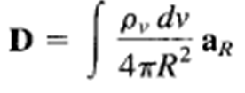
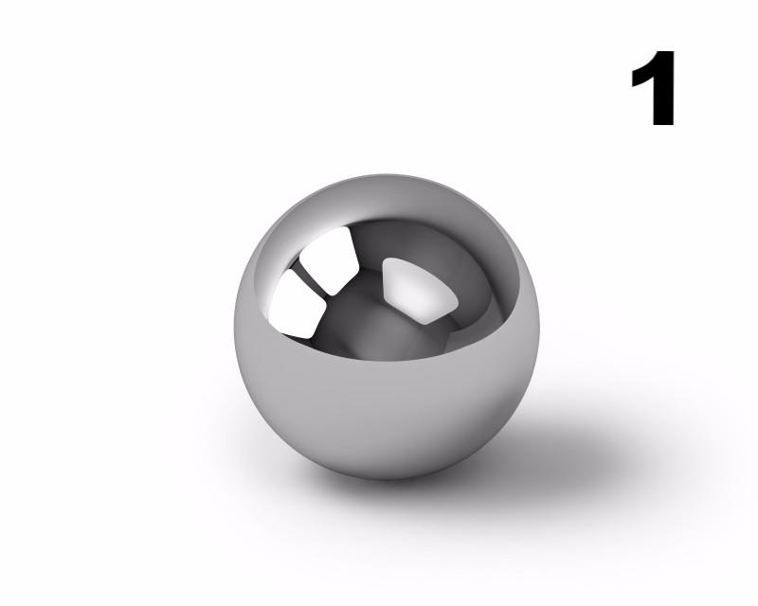
Electric Flux Density
The electric field intensity depends on the medium in which the charges are placed.
Suppose a vector field D independent of the medium is defined by
The electric flux ψ in terms of D can be defined as
The vector field D is called the electric flux density and is measured in coulombs per square meter.
For an infinite sheet the electric field intensity D is given by
For a volume charge distribution the electric field intensity D is given by
In both the above equations D is a function of charge and position only (independent of medium)

Slide 4
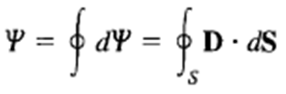


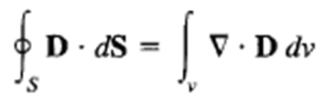
Gauss Law
It states that the total electric flux ψ through any closed surface is equal to the total charge enclosed by that surface.
Using Divergence Theorem
Comparing the two volume integrals
This is the first Maxwell’s equation.
It states that the volume charge density is the same as the divergence of the electric flux density.

Slide 6
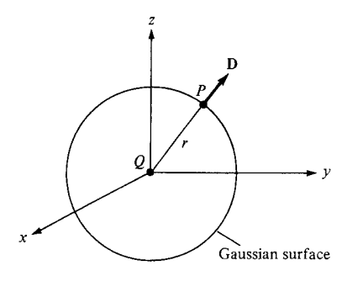



Application 1: Point charge

Slide 7
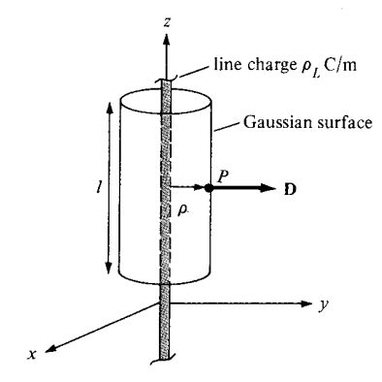


Application 2: Infinite Line Charge

Slide 8

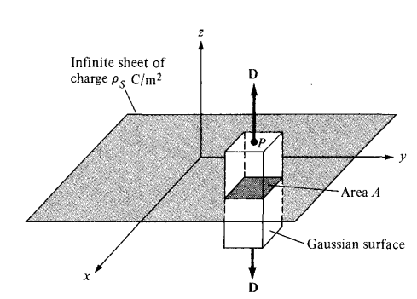




Application 3: Infinite sheet of Charge
Infinite sheet of uniform charge
Gauss’s law
And thus
or

